Slide 1
ACLS
Advanced Cardiovascular Life Support

Slide 2

Welcome

Slide 3
Objectives
Learn ACLS guidelines
Discuss the importance of high quality CPR
Learning stations
Practice codes

Slide 4
What is ACLS?
Intro to life threatening arrhythmias
Recognition of arrhythmias and cardiac arrest
Initial management of:
V. Fib/pulseless VT arrest
PEA/asystole arrest
Unstable tachycardia/bradycardia
Teamwork and communication during codes

Slide 5
Why ACLS
Spontaneous cardiac arrest is the leading cause of death in North America
VF seen on first assessment of 40%
Likely more have VF initially but have deteriorated by time of first contact
VF is a potentially treatable problem
Must be recognized and treated promptly

Slide 6
Science of Resuscitation
Video
Notes:
Stop at 6:40

Slide 7
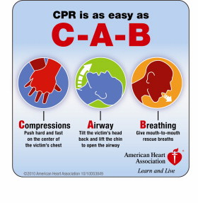
Compressions First

Slide 8
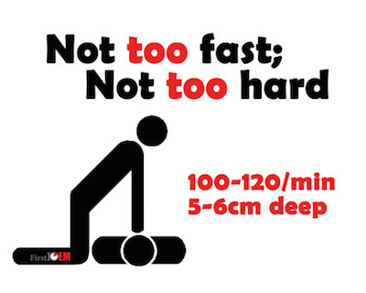
Emphasis on “Good Quality” CPR
Push hard (5-6 cm)
Push fast (100-120/min)
Allow for recoil
Minimize interruptions
Notes:
Get yourself in good position (bed height, stool)
Change CPR providers very 2 minutes

Slide 9
Emphasis “Good” Ventilation
Breaths 30:2 with BVM
Breath every 6 seconds (10/min) w/Advanced airway
Volume 500-600cc
Half-bag squeeze
Until you see chest rise

Slide 10
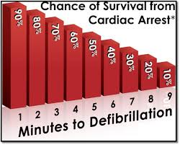
Emphasis on Early Defibrillation

Slide 11
Survival
Every 1 min delay to defib = 10% ⬇ survival
High-quality CPR slows delay to 3-4%/min
Compressions only
May increase bystander performance
Notes:
Seattle Pre-Hospital Survival 40%

Slide 12
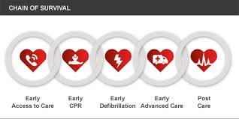
Chain of Survival
Notes:
Early recognition & call for help
Early provision of good quality CPR & Defib
Early recognition of reversible causes
Proper post-arrest care

Slide 13
Primary Survey
A – Airway
Oxygen, BVM, advanced airway, ETC02
B – Breathing
Spontaneous, Assisted (rate: 30:2 or 10/min)
C – Circulation
Monitors & IV access
D – Disability
Level of consciousness, pupils
E – Exposure
Other injuries
Notes:
Conscious Patient

Slide 14
Basic Life Support
Check Responsiveness
Call for Help
911, CCOT, Defib
Check Pulse & Breathing
< 10 seconds
CPR
Assist Breathing
BVM 30:2
Defib/Shock ASAP
Notes:
Unconscious Patient
What’s different in ACLS?

Slide 15
Epinephrine
VF/VT not given in first round
PEA given at outset
Myocardial irritation/ coronary spasm
Dosing 10 cc of 1/10,000 (1 mg)
Remains controversial

Slide 16
Amiodarone
VT/VF arrest
150 mg push bolus x2
No difference Amio, Lido, Placebo (May 2016)
Notes:
Amio 24.4, lido 23.7, placebo 21.0 % survival to hosp discharge (n= 3026)

Slide 17
Airway & ET CO2
Confirms tube placement
< 10 = bad prognosis
CPR marker = 12–15
ROSC – sudden rise

Slide 18
Secondary Survey
S – signs & symptoms
A – allergies
M – medications
P – past medical history
L – last meal
E – events leading to illness

Slide 19
Hs & Ts
Hypovolemia
Hypoxia
H+ (acidosis)
Hyperkalemia
Hypokalemia
Hypothermia
Tension Pneumo
Tamponade
Toxins
Thrombosis
Cardiac
Pulmonary

Slide 20
Hypoxia
Opioids
Pin-point pupils, low RR, decreased LOC
Assist ventilation (BVM)
Administer Naloxone
Anaphylaxis
Early airway management
IM epinephrine
Fluids (distributive shock)

Slide 21
Hypoxia
Asthma:
Tension pneumo
Auto peep
Mucous plug
Permissive hypercapnia
Airway obstruction
Ketamine, Mg Sulfate, Ventolin

Slide 22
Hyperkalemia
Check Lytes & ECG
Slow wide complex, peaked T waves
Administer
Calcium
Bicarb
Insulin / glucose
Ventolin
Kayexalate

Slide 23
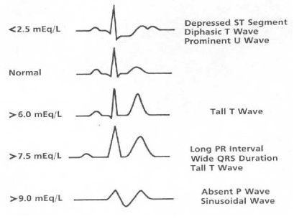
Hyperkalemia

Slide 24
Toxins
Beta blockers
Glucagon
High dose insulin
Calcium channel blockers
High dose insulin
Digoxin
Digifab
TCAs
Bicarb

Slide 25
Thrombosis
Consider PE
Lytic question
High risk situation
Consider ACS/STEMI
ECG
PCI vs. lytics (<2 hrs)

Slide 26
Course Overview
Interactive Course
Questions & Comments Encouraged!
Completion Requirements:
Pass High-Quality BLS Skills Test
Pass Bag-Mask Ventilation & OPA/NPA Skills Test
Demonstrate competency in learning station skills
Pass the Megacode Test
Pass the Open-Resource Exam (84%)

Slide 27

Questions?
Notes:
Divide into 2 groups - BLS

